Slide 1
Wellbeing Champions

Slide 2
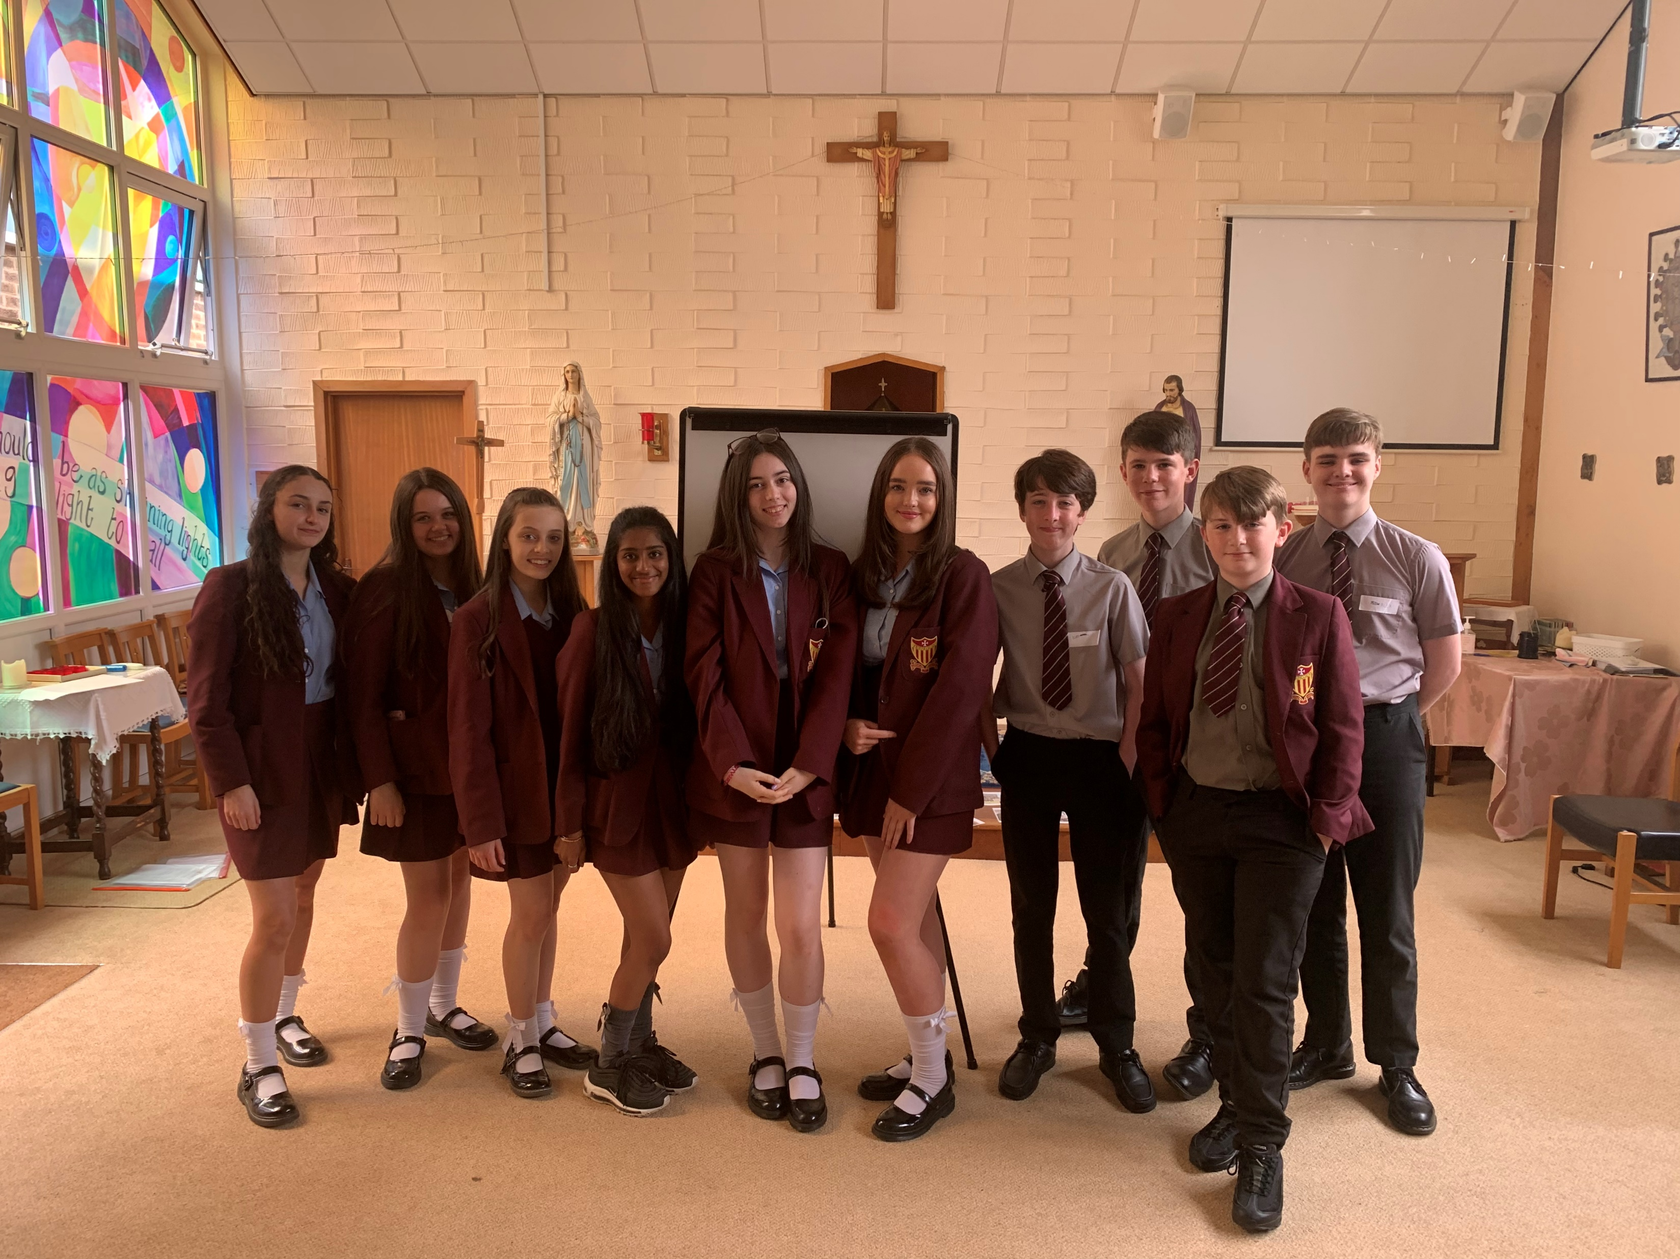
Who are we?
We are the Maricourt Wellbeing Champions and we are here today to give you an insight into what we do and how we can help. During last year, we received training to give us the ability to signpost you towards help and start an increase in awareness of mental health and how you can spot someone in need of support.

Slide 3
What do we do?
A Wellbeing Champion is one of your peers, who you can go to for advice on situations related to your mental health and wellbeing.
If it is a very serious situation which could be regarded as a safeguarding concern then we have to tell a designated member of staff to help you get the proper help that you might need.
There are 15 Wellbeing Champions that have been recruited and that you can go to if you need someone to talk to about an issue you may have.

Slide 4
What do we offer?
The main role we play as well being champions is to signpost any issues to the progress/ wellbeing leaders, when necessary. Although, we take confidentiality very seriously!
Instead of telling you how to handle a certain situation we’ll give you advice and options leaving you to feel empowered and in control.
We also offer designated time to listen to all your problems because we know the importance of being heard.
In addition we provide personalised support for each individual’s situation.

Slide 5
We’d be more than happy to share our own past experiences to show that no situation is permanent. As individuals we also develop our own coping mechanisms that could potentially be used to help you as well.
We establish a mutual respect for one another and we view each other as equals along with the fact that the majority of us have been in a similar situation.
Our role is also to break down the stigma surrounding mental health and make our school a place where we can openly talk about our well being.
We want to remind you that our school is a community that sticks together in order to make you feel accepted and more at home.

Slide 6
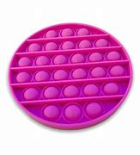
Resources
In the well being centre (located in Newman) we offer a variety of resources to help you manage stress and anxiety. Some examples of these are: fidgets, squishies and other sensory toys.
We also recommend the use of apps such as:
- Daylio, an app that helps you document your moods.
Calm Harm, provides distractions and alternatives to self harm.
Yesss, this isn’t an app but it’s a book that helps teenagers to grow in confidence and gives you tips on how to manage.

Slide 7
Thanks for listening, if you have any questions make sure you catch us after the assembly or if you see us around school.

