Slide 1
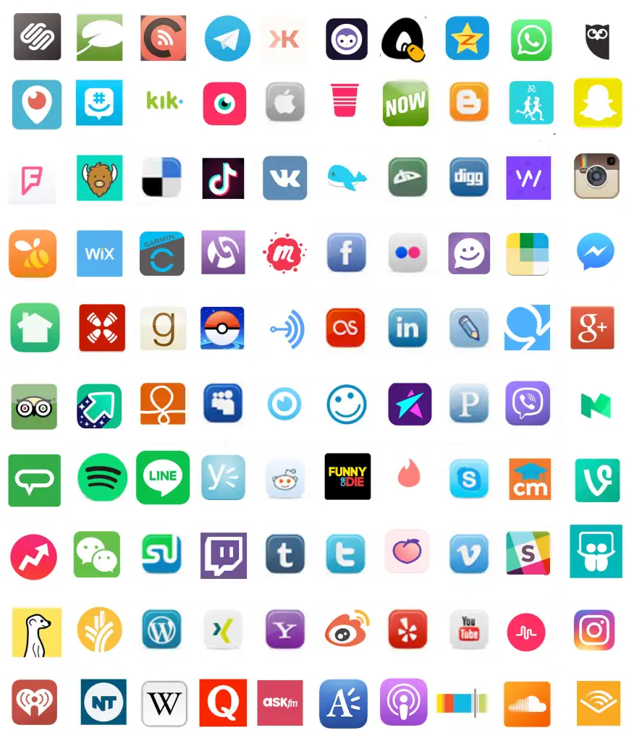
TITLES GEORGIA
BODY ARIAL- SLIDE 2
BODY ARIAL
BODY ARIAL
BODY ARIAL
BODY ARIAL
Notes:
You could start off with this to get them talking about the icons and settled at the beginning

Slide 2
Online Safety Assembly
DATE: November 2021

Slide 3
What is Online Safety?
Being aware of how to stay safe online with the different technology we use on a daily basis.
You need to know how the different technologies you use, can effect you now and in the future.
You also need to know how to use the tech appropriately and safely (do you know how to report abuse etc on all of the different tech/apps you use)
Notes:
Ask them if they know what online safety is. Tell them they will need to pay attention as they will be given a questionnaire to complete following the assembly. This should be a reminder to the pupils about things they should/ may already know but nevertheless is important.

Slide 4
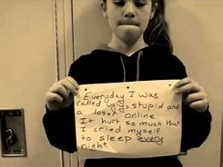
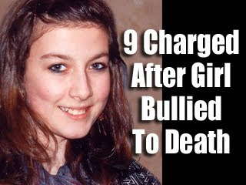
Cyber Bullying
What is it?
Cyberbullying is a form of bullying or harassment using electronic means.
Notes:
Ask the question and take some quick responses, the second click will bring up the answer.

Slide 5
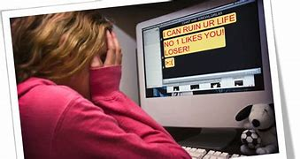
Types of Cyberbullying
Exclusion
Abuse
Outing
Trolling
Impersonating
Notes:
You can maybe ask the pupils what the different types are before showing them here.

Slide 6
Types of Cyberbullying
Exclusion
Stopping people from taking part in online
activity like a group chat or game.
Using online tools like social media to taunt
people not invited to activities.

Slide 7
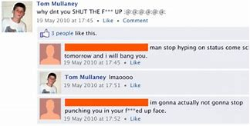
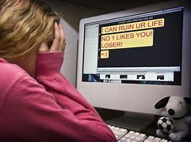
Types of Cyberbullying
Abuse
Sending abusive or threatening messages.

Slide 8
Types of Cyberbullying
Outing
Sharing private information about somebody to try and hurt, embarrass or humiliate someone.

Slide 9
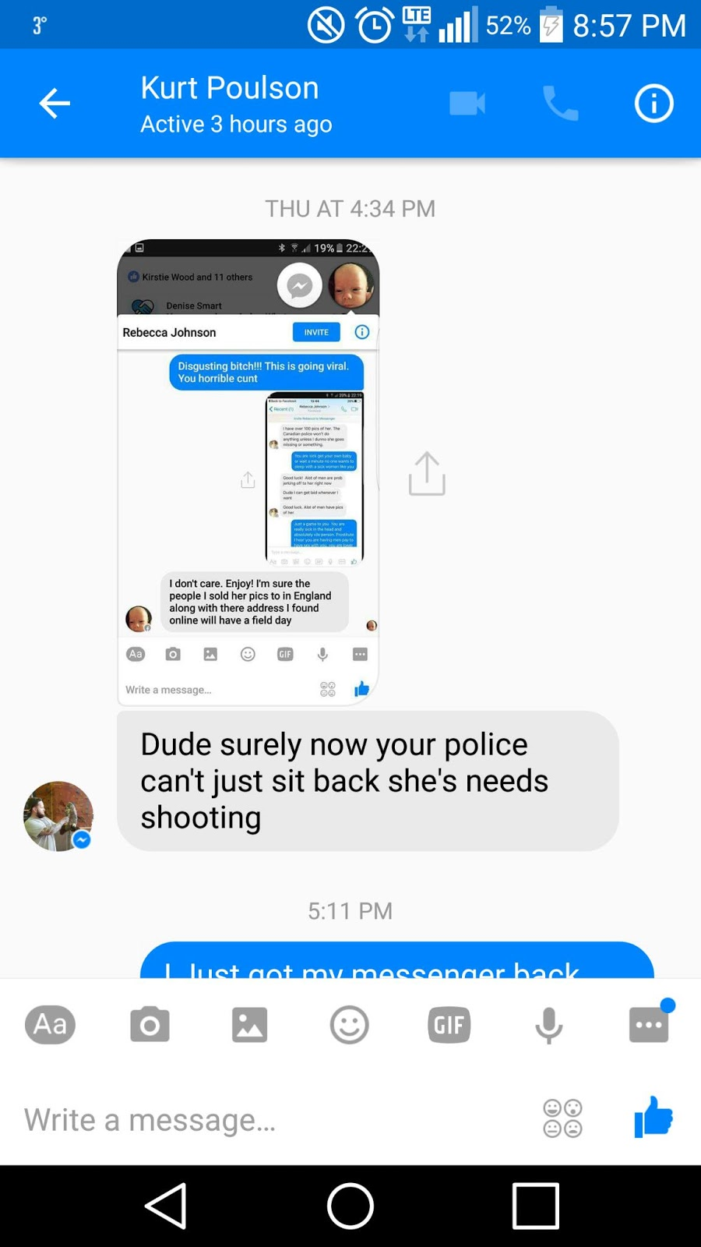
Types of Cyberbullying
Trolling
Trying to provoke reactions online. Searching chatrooms or social media groups often using bad language or extreme views to cause offence and upset.

Slide 10
Types of Cyberbullying
Impersonation
Pretending to be someone else online, making fake accounts or logging into somebodies account without permission.

Slide 11
Is Cyberbullying a Crime?
24% of pupils of KS4 age nationally said they have been bullied online.
Most bullying is not against the law, but it is never OK. Most social media apps and games, like schools, have rules which ban bullying behaviour.
However Some bullying behaviour is illegal. It is a crime if someone:
Forces someone else to do so something sexual or share a nude/semi-nude image
Shares, or threatens to share, an under 18 year old’s nude or semi-nude images
Bullying someone because of their race, gender, sexual identity, or if you have a disability
If someone is threatening or harassing you, this can also be a crime.

Slide 12
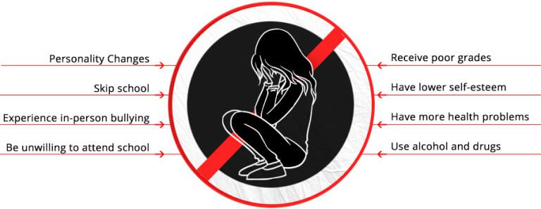
What are the consequences of Cyberbullying?
BODY ARIAL- SLIDE 9
BODY ARIAL
BODY ARIAL
BODY ARIAL
BODY ARIAL
Notes:
Tell the pupils consequences for the bully as well, could involve sanctions in school including exclusion, police intervention and the issues with digital footprints in the future.

Slide 13
What are the consequences of Cyberbullying?
Consequences for the bully can include
School sanctions involving exclusion.
Police involvement (serious cases have resulted in prison sentences)
Isolation for the bully when people dislike what they have done.
Negative digital footprint.

Slide 14
What can we do to reduce your risk of online bullying?
Keep all passwords private
Don’t share too much information online.
Don’t post things that you would be embarrassed if your family saw it
Know how to report on each app/technology you use.
Don’t be an idle bystander (call it out)
Make a copy (screenshot) of the bullying
Block bullies.

Slide 15
Grooming.
Grooming is when someone builds an emotional connection with a child to gain their trust so that they can exploit them in some way. This can be to abuse the child emotionally, financially or sexually. It can also be used to radicalise somebody into agreeing with extremist views or actions.
Groomers can be any age or sex.
You never know who is contacting you.

Slide 17
Grooming. Radicalisation
Political and religious extremist groups are now using online methods of grooming for recruitment.
Far right groups using social media have had huge success advertising extreme acts. ‘Britain first’ had 2 million likes on facebook before the account was deleted.
Gangs have also used social media and youtube channels which have been linked to a rise in knife crime in cities.

Slide 18
Grooming – What can you do to protect yourself?
Be suspicious. If somebody is showing you lots of attention and being overly kind, this should be an alarm bell.
Beware of ‘secrets’. Getting you to keep secrets is a key tool of groomers. If somebody wants you to keep things secret, then tell somebody.
Beware of games of 'dare'. These are a common tactic where the groomer starts with small dares but builds to things you would not initially agree to.
Beware of people with views that seem extreme. Talk to other people (including parents / carers) to gain a balanced view.

Slide 19
Sexting
In the summer term or recently for year 7 you all had the ‘send a pic’ training.
So what is sexting exactly?
Sexting is sending, receiving, or forwarding sexually explicit messages, photographs, or videos, primarily between mobile phones, of oneself or others. It is also know as nude image sharing.
Notes:
You can ask for replies here but judge the room first, maybe just tell them.

Slide 20
Sexting The figures
According to an internetmatters survey in 2020
17% of people 15 – 18 said they had shared a nude image of themselves.
1 in 6 people between 14-15 have sent an image of themselves.
During lockdown last year the police dealt with cases of people as young a 6 who were sexting.
Notes:
The point with this is to make sure they know how common it has become and maybe make a point of the last figure, they will probably be shocked about the age but make a point of that is how they appear to adults if they are involved at the teen years.

Slide 21
Scenario 1
Aisha aged 15 breaks up with her boyfriend Josh who is 16. Before they broke up Aisha sent Josh nude images of herself. After the break up Josh posted them online to get his own back. Who has broken the law?
Aisha
Josh
Both
Neither
Both
The Protection of Children Act states that it is illegal to take, send or possess sexually explicit or partially nude images of people under the age of 18 even if they took the image themselves.
The Police may…..
Interview both parties……take away his phone or other devices
The must deal with this type of incident in a proportionate way is again the individual's circumstance would come into consideration and they would also need t know if adults were involved in any aftermath. The priority being protecting the children from any harm.

Slide 22
Scenario 2
David was sent a nude image of a young person on social media. The type of app it was sent on meant it disappeared after he had seen it. Had David broken the law?
Yes
No- he doesn’t have the image anymore
Yes
David has broken the Law under The Protection of Children Act. The image was on his phone
The Police may…..
want to investigate depending on any previous history and may want to find out the identity of the person in the photo so that they can make school/parents aware in order to offer support.

Slide 23
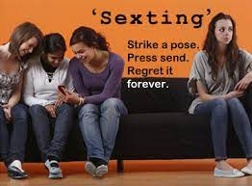
Sexting Consequences
Bullying
Isolation
Being blackmailed
Mental health effects (depression and self harm)
Images shared widely
Losing control of the images.
Notes:
Ask for some feedback here before showing these
You may want to expand on some of these effects.

Slide 24
The legal bit.
It is an offence for a person to take, distribute, possess, or publish indecent photographs of a child under 18.
This law was created to protect young people.
The police work under clear guidance that young people should not be criminalised for sending nude images of themselves.
However, it’s always wrong to share nude images of another young person without their consent and the police can get involved. If you are sending pictures of others you can be prosecuted. People have ended up on a sexual offenders register.
Notes:
Remind them that it is illegal to possess a picture even if they didn’t send it or take it.

Slide 25
What should you do?
Don’t take or send any pictures that you wouldn’t want your family seeing.
Never send a pic onto anyone else that could offend
Tell a trusted adult if you are worried
Don’t comment on pics
Don’t judge the person in the pic
Report the pics and any abusive comments, be a positive bystander.

Slide 26
Social Media – Did you know?
You all use some if not most types of social media and you know more about it than us. However there are things that you need to know.
Colleges, universities and employers search for people online and their digital footprint before interviews, of they don’t like what they see you're not getting a place.
If you are seen to bring your school or workplace into disrepute you can be permanently excluded or fired.
Notes:
Tell them that this has happened in schools and obviously has happened in recent history to sports stars, politicians and others like an apple employee from the Liverpool one apple store.

Slide 27
Social Media – Did you know?
Instagram’s default privacy settings are set to public, which leaves you open to bullies and risk of unwanted attention.
A survey by the Royal Society for Public Health found that Instagram caused more damage to young peoples mental health than any other social media platform.
Notes:
The mental health issue is linked to image and self esteem, influencers and unreal lifestyle aspirations.

Slide 28
Social Media – Did you know?
Snapchat is solely used by some people to bully people due to the messages disappear.
Messages are never fully ‘disappeared’ the police can easily request the data from Snapchat as it is not fully encrypted. Also people can screen shot the posts using other apps so others cannot tell it has been done.
The Snap Map has been used by stalkers and others to track and harass others.

Slide 29
Social Media – Did you know?
The minimum age for using WhatsApp is 16.
You can only be added into a group by one of your contacts but once in a group others can see your info like phone numbers and profile pictures.

Slide 30
Social Media – Did you know?
The minimum age for using Tik Tok is 13 like many social media apps. This is due to an American law that says companies cannot track the online use of those under this age.
However there are huge security concerns due to the data that is gathered through the app and what its being used for.
Some countries have banned Tik Tok and more are following.

Slide 31
Next steps
* Be careful online and use the technology in an appropriate manner at all times.
* Know how to use the apps/tech you use fully, set privacy to status to private or friends.
*Ensure you know how to report misconduct and any bullying behavior.
*Don’t join in- be a positive bystander, help people out. Call it out.
* Seek help if you need it from an adult. If things go sour you cannot deal with it yourself.

Slide 32
Next steps
* Make sure you know the key websites/ helplines that you can access for help.

Slide 33
Next steps
You will need to complete a short questionnaire that will test if you have been paying attention.
This will be through Show my homework and must be finished by

