Slide 1


Year 11 Information Evening
Preparation for mocks

Slide 2
Key Dates
6th Information Evening 30th November
Mock examinations 4th – 15th December
Mock Exam GCSE Grades 15th Jan
Gap Analysis Report 15th January
Parents Evening 23rd January

Slide 3
Mock Examinations 4th - 15th Dec
 | Papers | Length
English | 2 | 1hr 45
Maths | 3 | 1hr 30
Science Trilogy | 3 | 1hr 15
Separate Science | 3 | 1hr 45
RE | 1 | 1hr 45
History | 3 | 1hr 15, 55min, 1hr 20
Geography | 1 | 1hr 30
Spanish *Speaking exam will take place before these dates | 3 | H - W 1hr 15 , R 1hr, L 45min
 |  | F - W 1hr, R 45min, L 35min

Slide 4
Mock Examinations 4th - 15th Dec
 | Papers | Length
Art | practical | 2hr
Business | 1 | 1hr 45
Computing | 2 | 1hr 30
Construction | 1 | 1hr 30
Hospitality | 1 | 1hr 30
Health | 1 | 2hr
Music | 1 | 1hr 15
PE Sport & Coaching | 1 | 1hr 20
GCSE PE | 1 | 1hr 30
Textiles | 1 | 2hr

Slide 5
Continuing In-Class practical portfolio (No Mocks)
Performing Arts
IT

Slide 6
There are no secrets to SUCCESS
It is the result of preparation and HARD WORK
*attendance matters*

Slide 7
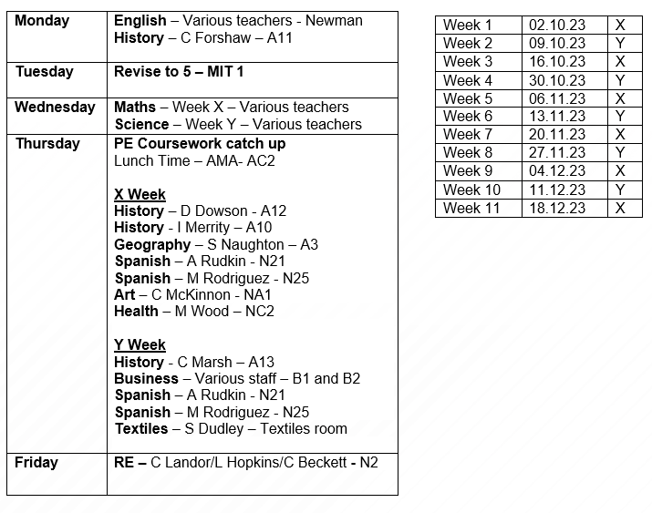
Year 11 revision schedule

Slide 8

Revise to 5!
Every Tuesday in MT1
Dedicated study time for Year 11
Quiet group or independent study
Access to computers
Study support
Revision materials provided

Slide 9
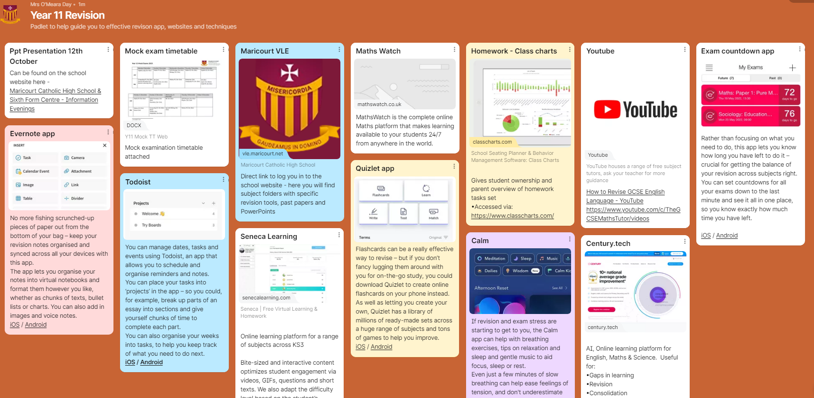
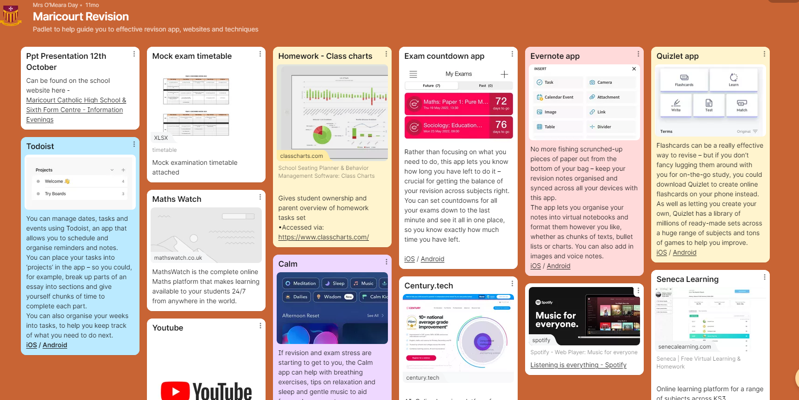
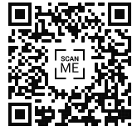
Year 11 revision Padlet
This QR code will take you to our Maricourt Revision Padlet

